Slide 1
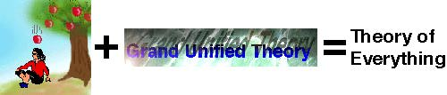
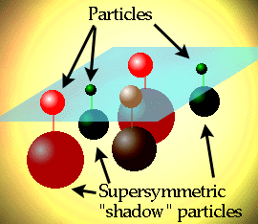
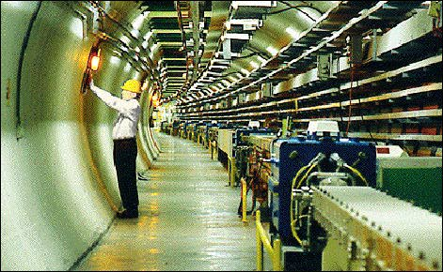
WELCOME TO PHYSICS 131
Physics 131
Lecture 1
Dr Paul Coop pcoop@une.edu.au
Dr Konstantin Pavlov kpavlov@une.edu.eu
Notes:
Welcome to physics 121.
We hope you will find the course interesting and challenging.
Physics is the science from which many other sciences branch out…
Scientific theory is a cycle of theory….exp …. Interpretation of results…..new theory…
Slowly following this process… we delve further into the mechanisms of Physical behavour….
Some may be revision for some people…. It doesn’t hurt to review some material….
Even though it may be similar…we may be looking at the same thing…...however with a more capable maths
Test at the same time as the lab- tues in the 7th week. Testing the first 6 weeks. Then another 7 weeks and the first semester test……testing only the 2nd 7 weeks.
Labs….Start next week- Pair sheet….Prac book
Info sheet…. Dates….. We used to Examine.. 1/2 semsester…. It is much preferred to test only 6 weeks at a time..so less stress and less material to cram…. So a test in the 7th week…
The textbook is University Physics…. 11th Edition….its a thick and costly book… I think about $140. It is a version of the book I studied 20 something years ago… and its improved since then…. Very good…
Assignment will be handed out soon- due in on the 6th week- last week of my lectures…again if you have troubles…. Ask…….
Lecture notes….
Online quiz – web CT 6 quizes in 12 weeks. This is the first trial- So let us know if you have any problems
Calculators- bring calculators to all lectures- we talk about developing an understanding of concepts- and this makes you versatile- however we can only test calculations and problems solving skills- practice these.
My intention is to do a few things.. To cover basic material that you will need later on….To keep the class together and develop efficient problem solving methods…..
There are some myths around, such as man didn’t actually land on the moon.
Another is that Physics is hard……we don’t expect you to “get it the first time you see an equation” and say “it all becomes clear now, I now see what I have been missing out on all these years”. Its always a case of seeing a relationship often in the form of an equation, then becoming familiar with it so that you can bend it to your needs….. During the year I will be trying to make you complete as many different problems as possible so that when you land that high paid job and you are asked to work something out, you can say “no problem”.
…… if questions you can ask me during, or after a lecture…
You can also ask any questions email me on this address….no matter how silly….

Slide 2
Improvements to course
- Changed to Moodle - a html based modular teaching learning platform.
-Lessons now online- rather than in a black and white booklet. This opens up endless possibilities.
Any errors or areas that can be improved let me know.

Slide 3
Week | Starting Monday |  | Learning material |  | Practicals: On-campus students Fri 2 pm | Practicals: Off campus students | Quiz | Quiz due date
Week 1 | 20 Feb | Mechanics | Introduction/Vectors |  |  |  | Quiz 1 | 12 Mar
Week 2 | 27 Feb |  | Motion |  | Lab 1 |  | Quiz 2 | 12 Mar
Week 3 | 5 Mar |  | Circular motion and Newtons laws |  | Lab 2 |  | Quiz 3 | 19 Mar
Week 4 | 12 Mar |  | Work, energy and power |  | Lab 3 |  | Quiz 4 | 26 Mar
Week 5 | 19 Mar |  | SHM and momentum |  | Lab 4 |  | Quiz 5 | 2 Apr
Week 6 | 26 Mar |  | Rotational dynamics and elasticity |  | Mid- Trimester Test covering first half of material |  | Quiz 6 | 9 Apr
Week 7 | 2 Apr | Electricity | Electrostatics |  |  |  | Quiz 7 | 16 Apr
Mid semester break (three weeks) |  |  | 4 day Intensive school 10-13 April
Week 8 | 23 Apr |  | Capacitance and DC circuits |  |  |  | Quiz 8 | 7 May
Week 9 | 30 Apr |  | Resistors and circuit applications | Lab 5 |  |  | Quiz 9 | 14 May
Week 10 | 7 May |  | AC circuits | Lab 6 |  |  | Quiz 10 | 21 May
Week 11 | 14 May |  | LRC circuits | Lab 7 |  |  | Quiz 11 | 28 May
Week 12 | 21 May |  | Magnetism and electromagnetism | Prac catchup- for those students missing a practical |  |  | Quiz 12 | 28 May Quiz results will be taken from Moodle at 11pm on this date.
Week 13 |  |  |  | Final examination covering for second half of material in examination period

Slide 4
Components of PHYS131
Item | Worth %
Quizzes | 20
Lab work | 20
Mid Trimester test | 30
End Trimester test | 30

Slide 5

We are very strict with marks here at UNE

Slide 6
Lectures
Try to attend lectures.
They are not a session of sprouting information, but work session, where you can develop techniques and confidence at solving problems
Bring a calculator and a sharp mind.
Textbook – University Physics – Published by Pearson
– First Australian edition - any older version is OK.
Pearson publishing runs www.masteringphysics.com
web site
Good for examples animations and practice.

Slide 7

On line quizzes
First quiz orientation
11 quizzes worth 20%
Not compulsory though very good idea.
Due last day of lectures. Try to finish according to schedule
Any question or problems email me immediately
pcoop@une.edu.au
Web page found by going to www.une.edu.au
Click on my courses, then click on physics. The Moodle lesson delivery system shows lessons and quizzes for each week. The current week is shown in green.

Slide 8
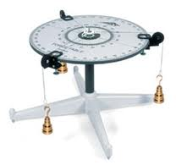
Lab work – not every week Fri 2 pm Stokes building
Need 6 assessable pracs worth 20 %
In physics, no need for lab coats- they will only get in the way, though wear covered shoes.
Try to pre read pracs- you will be informed of your experiment schedule ASAP.
Pracs start at 2 pm Fri and finish 5 – 5-30. Hand in prac report to lab demonstrator
Consist of 15 min prelab talk to develop strategy, by lab demonstrator – make full use of them.
Some pracs – fill in the blanks in lab manual and hand in.
Some require complete write up. Hand in at the end of each prac.
Need: Pens, pencil, ruler and calculator. Also Science write up book (i.e graph paper on every second page) for the laboratory work.
You will be given a hard copy of lab manual at introductory session. Electronic copy on website.

Slide 9
For externals
Intensive school 4 days.
First day revision/questions
Second day Mid semester test
Remaining time 6 lab sessions

Slide 10

Why use Science?
Makes things easier

Slide 11
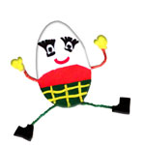

Why use Physics? Physics is the science of what happens if…
Careful measurement.
Use of relevant equation.
Outcome

Slide 12
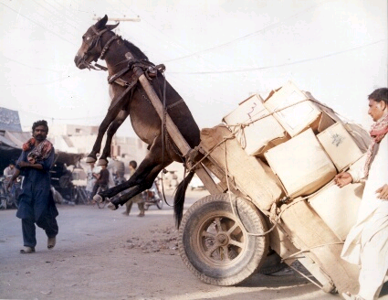
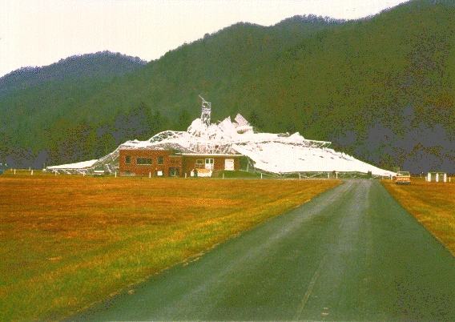
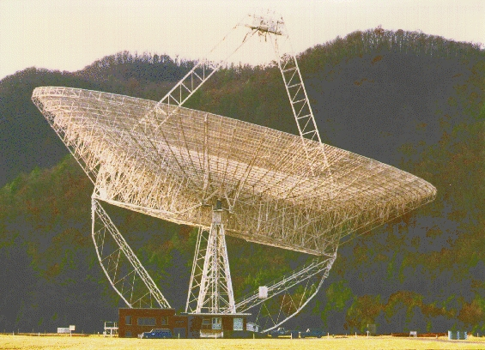
Science isn’t always right

Slide 13

See if you can predict what happens if…

Slide 14
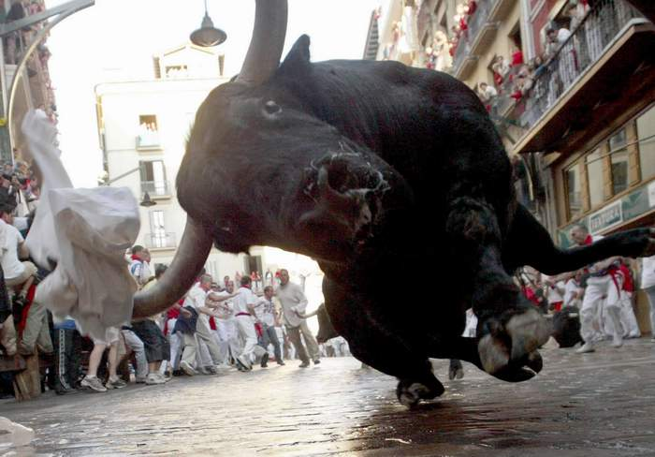

Slide 15



Slide 16


Slide 17


Slide 18
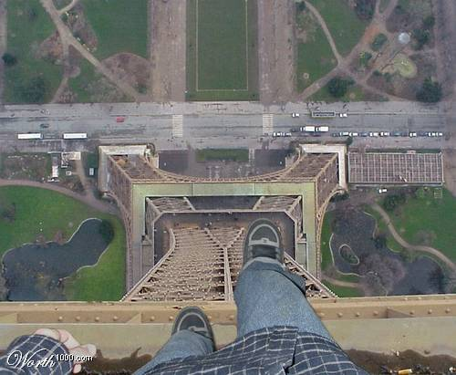
Notes:
I shudder every time I look closely at this photo…

Slide 19
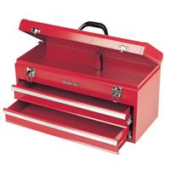
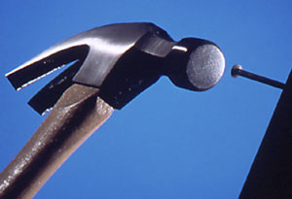
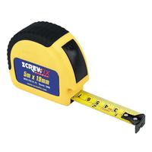

To find out what happens if… need to understand behavour.
Tools: Equations- need an input and provide an output
..and Accurate Measurement
Notes:
Just like a carpenter uses a hammer and tape measure.
Physics uses maths and measurements.
Try to think of maths as a tool that helps you arrive at an answer… rather than an obstruction.
Maths uses Equations to make predictions of behavior of energy and matter.
The other tool is accurate measurement- a builder uses a tape measure. Physicists use a range of sensing devices to be able to write down what is happening.
Its OK to say a runner or swimmer went very fast- but we have no real idea until it is measured accurately.
Olympic pools go to great extents to measure the lap time.
From an accurate measurement of what is happening we can use maths… to make accurate predictions about what is going to happen.

Slide 20

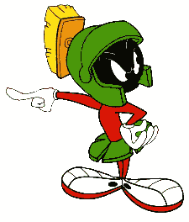
Uncertainties
When making any measurement you need some idea of how sure you are of the measurement- this is called uncertainty. (All found in, University Physics 1.5)
Try to use the term uncertainty rather than error- as errors are definite mistakes.
Try not to use the term “human error”, as this doesn’t describe the type of uncertainty.
In writing up experiments, it is best to simply state in conclusion… “The main causes of uncertainty were …..” (and list them).
There was “Martian error”

Slide 21
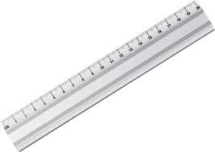
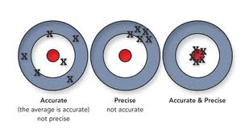
Some types of uncertainty
Limits of resolution – each measurement ½ smallest division
Precision
Accuracy
In experiments you will arrive at an answer with an uncertainty.
This answer can often be checked with tabulated values. You are not expected to arrive at that exact tabulated value. There could be a very good reason why it is different.

Slide 22
Significant figures and uncertainty
When writing final answers the number of figures tells the reader how uncertain is the result.
If you write down:
6.2 (2 significant figures) could contain 10% uncertainty 6.2 means 6.2 ± 0.1
6.23 could contain 1% uncertainty.
6.233 could contain 0.1% uncertainty.
So if you write down an answer to a practical
6.34523453423453 you must be pretty darn sure that you have got exactly the right answer.
Usually answers for pracs contain 2 or 3 significant figures, 4 at most

Slide 23
When doing experiments – complete experiment, and then go back an collect the uncertainty for each measurement, so you can calculate the final uncertainty.
2 types
Absolute uncertainty
Relative uncertainty and percentage uncertainty
Every measurement has an uncertainty associated with it.
This can be expressed as absolute units
Absolute uncertainty M = 14.6 ± 0.5 kg
Or as relative uncertainty 0.5/14.6 = 0.034
Percentage uncertainty 0.5/14.6 x 100 = 3.4 %

Slide 24
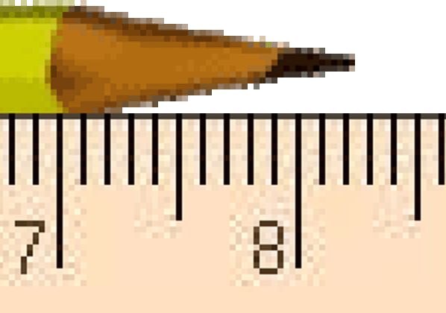
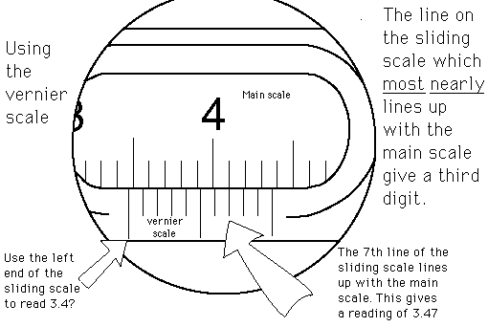
Examples:
How long is this pencil?
8.2 cm
You are allowed to guess the last figure, so I’d say 8.24 cm
Make this measurement using a vernier scale
Read the first mark on the vernier scale 3.4?
For the last figure, count along the vernier scale until the marks line up exactly. 3.47

Slide 25
Multiplication or division: the result should have no more significant figures than in the number with fewest significant figures:
3 2 4 9 minimum is 2 number of significant figures
5 3 6 minimum is 3 number of significant figures
Addition or subtraction: the result should have the fewest digits to the right of the decimal point
In practice: easier to average significant figures, as not always clear how many sig figures in calculation.

Slide 26
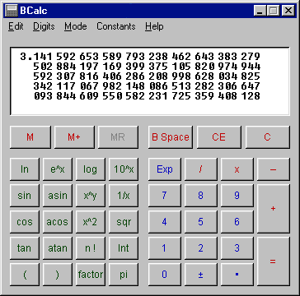
Want Pi to about 1% uncertainty. How many figures do we write down as a final answer?
3.14

Slide 27
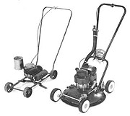
Today: Vectors
The difference between a vector and a scalar quantity.
The distinction between distance and displacement.
Addition and subtraction of vectors
Components of vectors
Unit vectors
The scalar product or dot product.
All found in Young and Freedman, University Physics: 1.7 – 1.10
Not Victors
Notes:
Before we can look at motion at all we need a few tools to help us….
So todays topic is about vectors….

Slide 28
Vectors and scalars
Scalar quantity– a physical quantity described by a single number eg. time, temperature, mass, density, electric charge.
Vector quantity– a physical quantity described by both magnitude and direction eg. the motion of an aeroplane, displacement, position, velocity, acceleration, force.
a vector
Notes:
Lets look at actual quantities…..
There are two types of quantities in science.
Scalars- are quantities with only magnitude- like time temperature mass, density, electric charge.
Vectors- are quantities that have both magnitude and direction--- eg velocity, force, acceleration…..
If we look at speed….. You can see that for instance if we say that an aeroplane has a speed of 1000 km/hr (a scalar quantity – just a number) so if we want to find out where the plane is going we need to add direction- which turns it into velocity….So velocity is a vector…..
If we are talking about force……If we apply a force to an object the direction is important- so force is a vector. So how hard we push is important- the magnitude-
So Vectors have magnitude and direction and the direction can be –ve or +ve….if we have a velocity to the left we can define it’s direction as +ve. Then a velocity to the right will obviously be –ve in direction. You chose which way is positive x and positive y, can be anywhere so long as you stick to it.
In order to distinguish vectors from scalars we usually write vector quantities in bold or with an arrow on the top or a line underneath (like v) – SHOW ON BOARD

Slide 29
Scalar Vector
Density
Mass
Acceleration
Time
Temperature
Force
Pressure
Intensity
Velocity
Speed
Scalar or Vector: density, mass, acceleration, time, temperature force , pressure, intensity, velocity, speed
Notes:
Are these quantities scalar or vector?
Is the following a scalar or vector?
@ Density
@ …mass?
@……. acceleration,
@, time
@ temperature
@ Force
@ Pressure
@ Intensity
@ Velocity
@ Speed

Slide 30
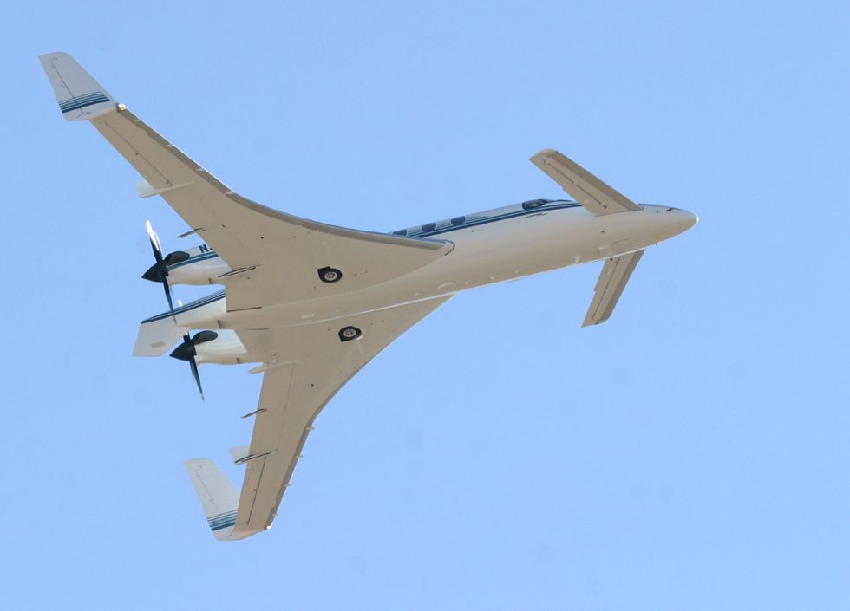
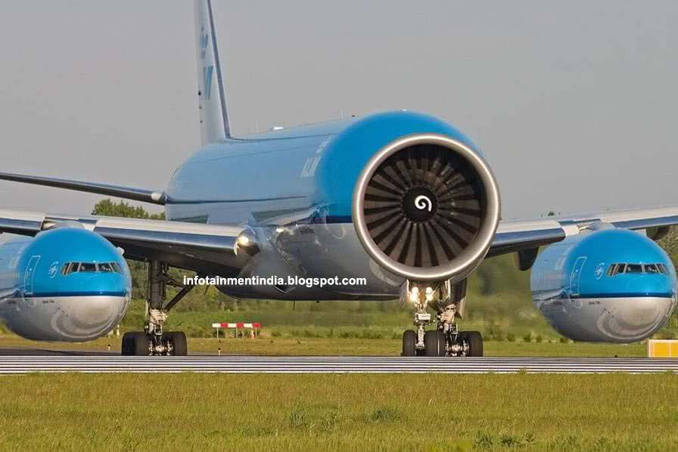
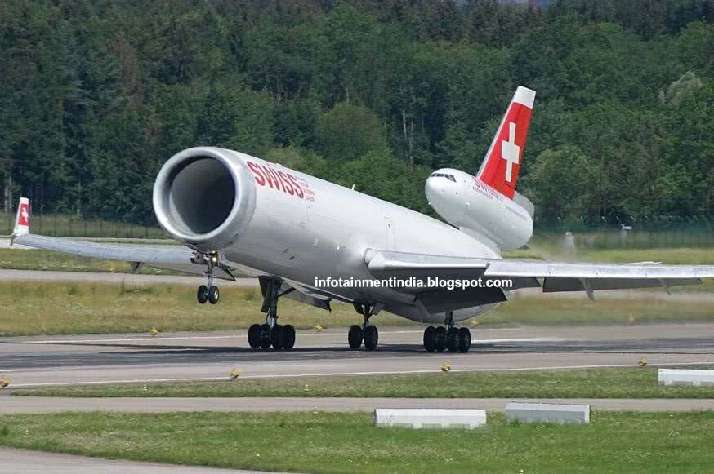
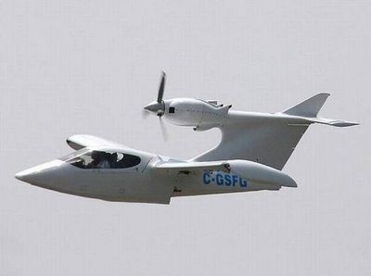
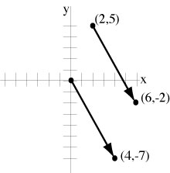
The vectors can be repositioned...Can move to origin or add tail to head. Doesn’t really matter where the engine is on plane – so long as pushing backwards.
You can move a vector parallel to itself. The vector from (2,5) to (6,-2) is the same as the one from the origin to (4,-7)

Slide 31
Vector addition and subtraction- in a straight line 1D.
The vector produced by adding or subtracting two or more other vectors is called the resultant
10 N
10 N
The resultant force is +20 N.
20 N
Notes:
We can add scalars very easily….
Since it is a quantity that has magnitude only. An example would be adding up money in your wallet. Money has a magnitude assigned to it but not a direction. What is $10 + $10 ? $20. That’s two scalars added together.
What about vectors?
The sum of vectors is called the resultant, and the resultant is the same as the two vectors. It is also a vector- so it has magnitude (how big it is) and direction.
The unit for force is the Newton N.
So the resultant of 10 N + 10 N in the same direction is +20 N. in the same direction- to the right.

Slide 32
Vector subtraction in a straight line (1D)
-
10 N
4 N
Add negative vector
+
10 N
4 N
Add them head-to-tail
Answer = 6 N
Notes:
So in one dimension…. This means along a straight line. If the vectors are in the same direction … you add.
If in opposite directions work out which one is in the positive direction and subtract the other.

Slide 33
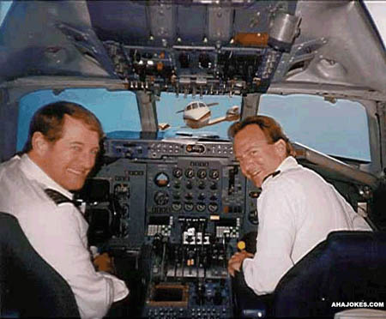
Problems with vectors
Notes:
Another example of vectors in a straight line is contained in this picture.
These pilots probably will not have a big grin for long…

Slide 34
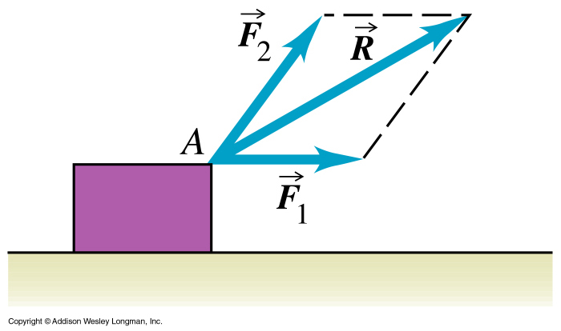
Adding vectors in different directions (2D)
Notes:
What happens if the vectors are in different directions like these two forces pulling this box……
This is a 2D problem… lets have a look at 1D first……

Slide 35
Unit Circle- Directions
Notes:
Here is the usual angle of vectors- as measured on the unit circle…. The angle is measured from the + x axis…..
Notation for direction 3 oclock = zero.

Slide 36
Vector addition – order DOESN’T matter !! = Commutative
Add head-to-tail
Resultant force is 50 N
30 N
40 N
40 N
30 N
Add head-to-tail
Resultant force is 50 N
Notes:
Does the order matter when we add vectors?
Does it matter is the 40 N force was drawn first …. As in the top diagram
Or last… as in the lower diagram……….No!! see the green resultant vector is still the same magnitude and in the same direction.
Because the order doesn’t affect the result- Vector addition is commutative.

Slide 38
Vector addition – 3 methods
1. Graphical- using a scale and drawing the vectors.
2. Geometric- using trig and Pythagoras
3. Component-very reliable method of dividing the vector into x and y components, then adding.
Notes:
How do we calculate the resultant of adding vectors together which ate in different direcitons.

Slide 39
Vector addition – graphical method
+
30 N = 30 mm
40 N = 40 mm
Add tail to head
Resultant force is 50 mm =50 N
30 N
40 N
θ
Use protractor to measure the angle
Notes:
The first method we’ll study is the graphical method.
So if we need to add the two vectors 40 N to right and 30 N up…….
Make a scale…… say 1 mm for 1 N.
We Draw the 40 N to the right….. 40 mm to right
Then join the tail of the 30 N force to the head of the first force.
So the second 30 N force starts at the head of the first and goes 30 mm up.
The resultant is then drawn from the beginning of the first force to the end of the last force.
This can be measured- and in this case found to be 50 mm.. Which corresponds to 50 N
You can add as many forces as you wish- joining tail to head and drawing them in with a protractor.
The resultant force will be the distance from the beginning of the first to the end of the last.

Slide 40
Vector addition – trigonometric method
Fit a right angled triangle
Resultant force with magnitude C
Force with magnitude B
θ
Force with magnitude A
Could also use
Sin or Cos rule
Notes:
We can also use a Trigonometric method- for vectors….. If we can fit a right angled triangle to the the vectors..
Instead of using scaled drawing- we can roughly map out the problem.
The trig method relys on magnitude and angle.
You still draw them tail to head- though pythagoreus theorem is used to calculate the resultant…..- the hypotenuse of the triangle.
The direction can be determined using the tan trig function of opp/hyp.
So the resultant can be found by putting in the values for the magnitude of A and B. In our case it is 40 squared plus 30 squared all square rooted. This comes to 50 N.
The angle between A and B is tan ^{–1(} B/A) so we can find the angle at which the resultant acts also. In this case it is tan ^{–1(} 30/40) which is 37 degrees.
(DRAW on board where put resultant magnitude is 50 N and resultant angle, direction of force, is 37 degrees).

Slide 41
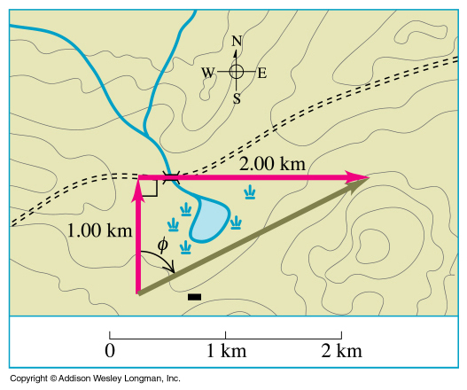
Example- Trig method- add the vector 1.00 km N to the vector 2.00 km E to obtain the resultant displacement
Notes:
Let’s do a simple example of vector addition.(example1-5) A cross country skier skis 1.00 km N and then 2.00 km east on a horizontal snow field (ie we’re looking at just the two dimensions, N and E). How far and in what direction is she from the starting point ?
We need to find the resultant to answer this question . Well start by drawing the diagram using vectors to represent her displacement (ie direction and magnitude). You can draw it to scale and measure but a much more accurate result can be found using calculations. Remember to draw the vectors with the tail of one at the head of the other.
Use Pythagoreus theorem to find Resultant displacement….
1 squared + 2 squared = R squared.
@
Well that’s a fairly simpler example where the vectors happened to be at right angles. When that is not the case we need a more general method. The method of adding component vectors.

Slide 42
Example- Force vectors- Trig method
A plane is flying West with a force of 5MN. It encounters a Southerly side wind of 1.5MN
What is the Resultant force on the plane? What direction will the plane really fly?
R² = (1.5)² +(5)²
R=5.22 MN
θ = tan⁻¹ (y/x) = tan⁻¹ (1.5/5)= 16⁰ North of West
Notes:
Draw vectors on board
So we can work out the real direction and velocity the plant is travelling in…..
Question
A plane is flying West with a force of 5MN. It encounters a Northerly side wind of 1.5MN
What is the Resultant force on the plane?
R² = (1.5)² +(5)²
R=5.22MN

Slide 43
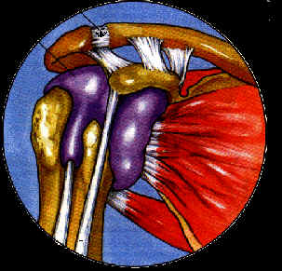
Difficult to add many vectors together geometrically …...So resolve them into x and y components- then add.
Addition of all fibres of muscle
Resultant force
Notes:
What about having solving many vectors in different directions as in the shoulder- where there are many muscles pulling in different directions…… the resultant can be found by the graphical method– though a bit clumsy- by the time you work out the scale and draw each vector in….Then measure the resultant…...

Slide 44
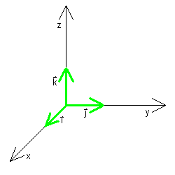
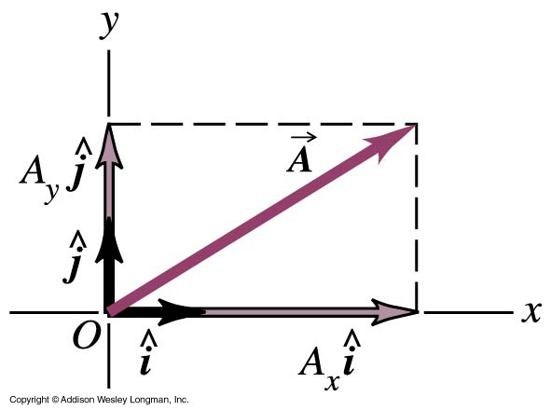
Adding vectors with the component method Define Unit Vectors with a magnitude of 1 and describe a certain direction in space.
Purpose of unit vector is to identify direction
Think of ĵ as short for “in the y direction”.
The letters x,y and z are often used as variables so i, j, k are used to name the unit vectors.
Notes:
UNIT VECTORS
A unit vector is a vector that has a magnitude of 1, with no units. Its only purpose is to point, ie to describe a direction in space.
A unit vector is given a hat to distinguish it from other vectors eg (as shown )
In an x-y coordinate system we can define a unit vector i that points in the direction of the +ve x-axis and a unit vector j that points in the direction of the +ve y axis.
You can see that this means we can now describe the vector A in terms of its components as shown. The Ax describes the magnitude and the unit vector bit gives a direction.

Slide 45
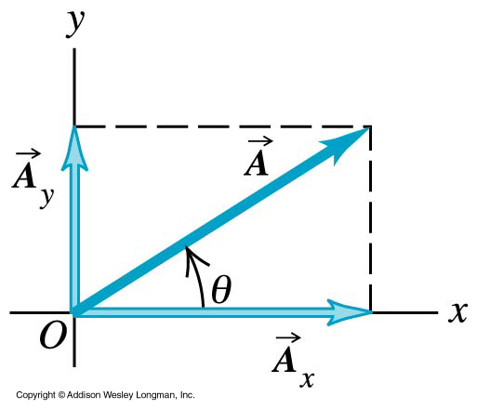
Components of vectors
Vector addition – Component method
Any vector can separated- or resolved into two
vectors on the x and y axis whose resultant is the original vector.
These come from trig functions for right angled triangle
Sin = opp/hyp
Cos = adj/hyp
SOHCAHTOA
Notes:
Component Method of vector addition.
A much more powerful method of vector addition or force addition in our case, is called the component method.
In this method we can separate any vector into just two components…
..one in the x direction and one in the y.
If You can split all our forces into two components we then have two 1-D problems rather than one 2-D problem.
(DRAW ON BOARD).
So what we do is we take a force vector, place it in an x-y coordinate system where the axes are perpendicular with its tail at zero and then separate the force into a force along the x axis and another along the y axis.
Ax = A cos theta, Ay = A sin theta
We say that these two force vectors Ax and Ay are the component force vectors of force A. The component of A along the x-axis is Ax and along the y axis is Ay. These components are just
We can then add any number of vectors by just summing the x components and the y components….
What is the resultant of these components? Well we can use Pythagoras again…..to find magnitude….
Tan-1theta = comy/comx.

Slide 46
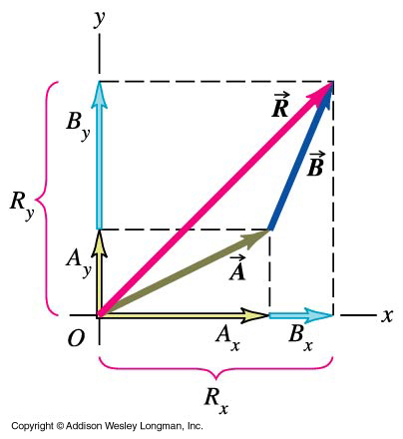
If have two vectors and the addition of both is called the resultant.
Magnitude of the resultant vector
Direction of the resultant vector
Notes:
Here is an example…. Adding two vectors in different directions…
Resolve each vector into a x and a y component
Add the component
Then use pythagorus’s theorem to calculate R and tanto calculated angle….

Slide 47
Example- Adding vectors using component method
Vectors in components
x-direction 0+3cos(45)+5=7.12
Y-direction 1+3sin(45)+0=3.12
y
3
3.12
1
45⁰
7.12
5
x
Notes:
This is a worked example of adding two vectors using the component method…..
@
In x direction we have 5 + 3cos45 + 0 = 7.12
In y direction we have 1 + 3cos 45 + 0 = 3.12
So the original 3 vectors can be replaced by two components.
Now we need to find the resultant vector
@
R2 = X2 + y2
Angle tan-1 y/x = 23.6^{0….}

Slide 48
Example- Adding Vectors using components
Another method to give vector coordinates is in brackets
So 7 in x-direction and 3 in y-direction = 7i+3j = (7,3)
4 in x-direction, 4 in y direction = 4i+4j=(4,4)
-1 in x direction, 2 in y direction = -1i+2j=(-1,2)
y
(4,4)
(-1,2)
(7,3)
x
Notes:
The vectors may be written in coordinate form- this makes it easier. Because components are written into the location of the point.
Ie for the lowest- near the x axis its coordinates are: x = 7 y = 3.
Sum x = 10 Sum y=9
Magnitude R = 13.5 θ= tan-1 y/x = 42⁰.

Slide 49
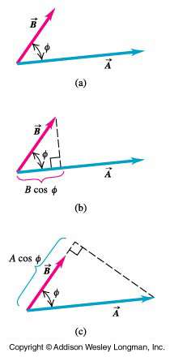
Scalar (Dot) product
The dot product is defined as the magnitude of vector A multiplied by the component of vector B parallel to vector A. It is a scalar quantity
Notes:
We’ve dealt with vector addition, what about multiplication ?
Two types of vector multiplication. We’ll deal with one here. The scalar product.
The scalar product (or dot product) is defined as the magnitude of vector A multiplied by the component of vector B parallel to vector A (B COS THI). It is a scalar quantity.
It is written as shown.
The scalar product of two perpendicular vectors is always zero (cos 90 = 0)
Let’s see what this means for the scalar product of A and B when using the unit vector notation. SEE MY SHEET, 4TH EXAMPLE.plus do example 1-10 on next slide

Slide 50
Example- Dot product
Find A·B if A and B are 55⁰ apart and both 2.00 m in magnitude.
2.00 m
A
55⁰
B
2.00 m

